Slide 1
Online job portal
PRESENTED BY –
Anshika Sharma( 2000290140021)
Chandresh Gangwar(2000290140037)
Mentor name – Dr Arun Kumar Tripathi
Professor, Computer Application Dept.

Slide 2
PROBLEM STATEMENT
In this COVID era, a lot of peoples lost their jobs and also new Job-seekers (Freshers) are not able to get a job due to the LOCKDOWN period, as they did not go outside of their homes. Many Employer, who want to hier employees are also not able to hier due to this problem.
To overcome this problem, a system is needed which can help the Job-seekers as well as employers in adopting new and modern methods of hiring, as well as, help them in saving time and getting a job from home by making all the process of hiring virtually or online.

Slide 3
OBJECTIVE
This project aims to develop an online recruitment portal for corporate HR groups .Some of the features of this system are creating vacancies, saving candidate data, starting the interview process, scheduling interviews, saving candidate interview results, and finally recruiting candidates.
For a candidate, it can provide a number of jobs available, posted by different companies, the candidate can search for his desired job via job id, job name, company name etc..
You may need a report to use the human resources team. This system automates the manual hiring process. We believe that if an organization chooses to use this system, it will eventually realize the value and need for this system and understand the issues associated with the manual process. Its data and contents are updated every time a user accesses them.

Slide 4
FUNCTIONAL REQUIREMENTS
For Admin
Manage Job-seeker and Employer profile.
Manage payments of both job seeker and employer.
Provide roles and authentication to the users.
Update the UI and services as needed.
Admin can add/delete/approve/disapprove any job request. Etc.
For Employer
Ability to post jobs with detailed description (job title, company name, company URL, location, salary etc.
Update profiles, jobs etc. on time as needed.
View and download the submitted CV’s by Jobseeker
Contact to the job seeker and provide the information and take the necessary test etc.

Slide 5
FUNCTIONAL REQUIREMENTS
For Job- seekers
Apply for a job with the click of a button.
Job seeker registration
Resume posting
Login and update profile accordingly
Search jobs by location, qualification, company, category, experience and with other keywords
Apply for the job
Having good internet connection etc.

Slide 6
NON FUNCTIONAL REQUIREMENTS
Secure access of confidential data (user’s details).
24X7 Availability.
Better component design to get better performance at peak time.
flexible service based architecture will be highly desirable for future extension.

Slide 7
Software requirements
Language: Javascript and php
Web technology: php
Front-end design: Html, CSS, JavaScript
Database: MYSQL
Server: xampp server,phpmyadmin

Slide 8
Hardware requirements
System operation: Windows 10 or later
Ram: 4 GB
Hardware capacity: 2 GB
Processor: Intel Core i3

Slide 9
Modules of the Project
Admin
Job Seeker
Employer
Authentication

Slide 10



SOFTWARE & TOOLS USED
Eclipse IDE
Ranorex
Notepad ++

Slide 11
DESIGN COMPONENTS

Slide 12
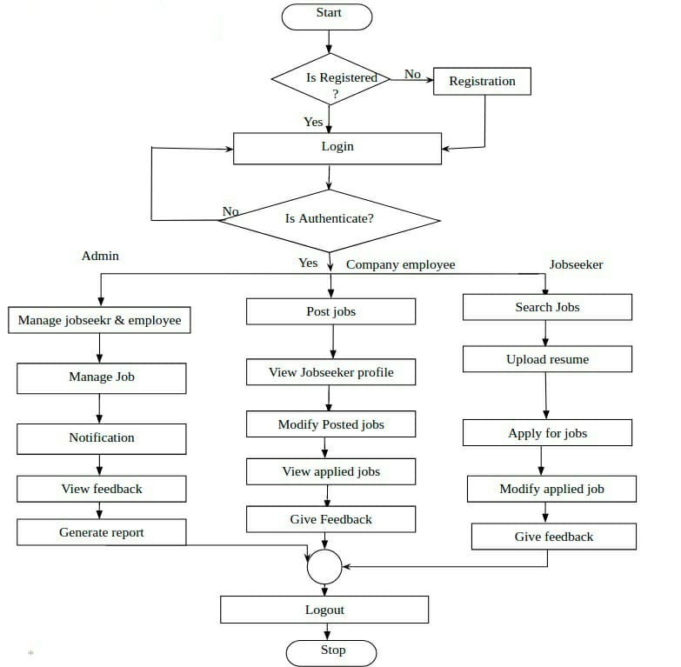
FLOWCHART

Slide 13
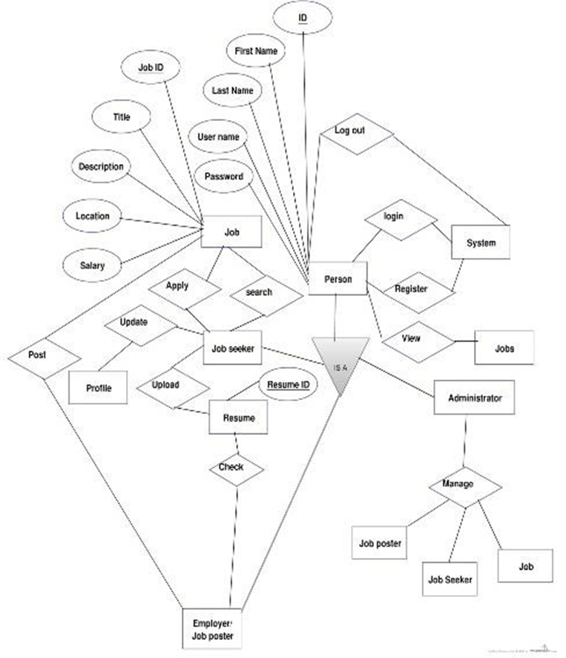
ENTITY RELATIONSHIP DIAGRAM

Slide 14
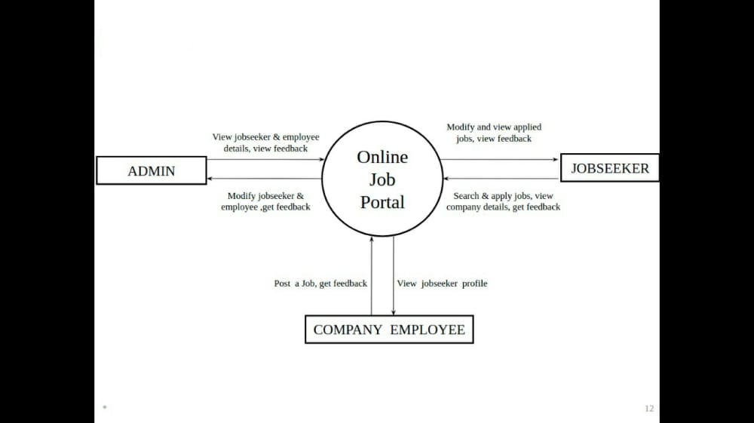
Data Flow Diagram

Slide 15
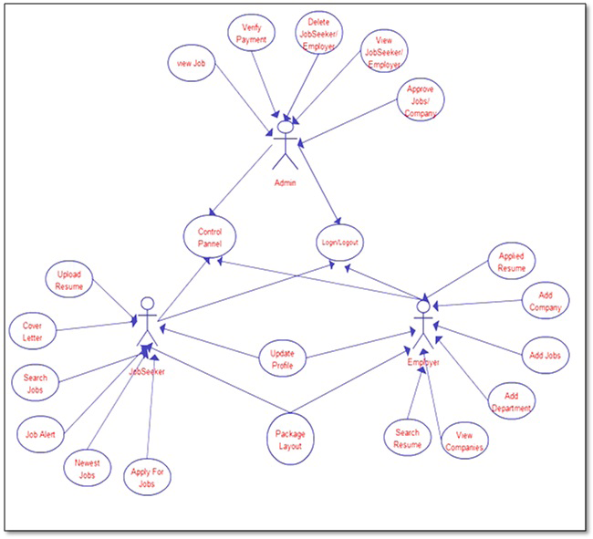
USE-CASE DIAGRAM

Slide 16
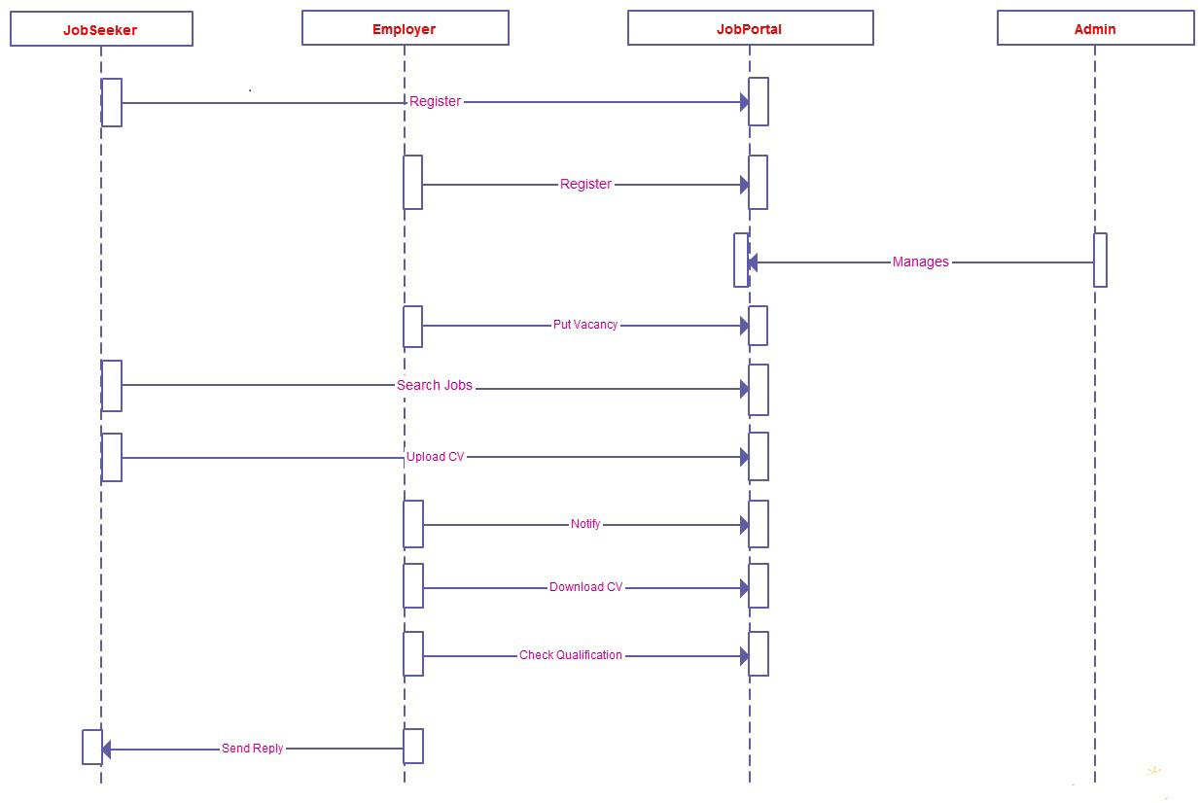
SEQUENCE DIAGRAM

Slide 17
THANK YOU
PRESENTED BY
Anshika Sharma
Chandresh Gangwar

